Slide 1

Power Of Storytelling
J

Slide 2
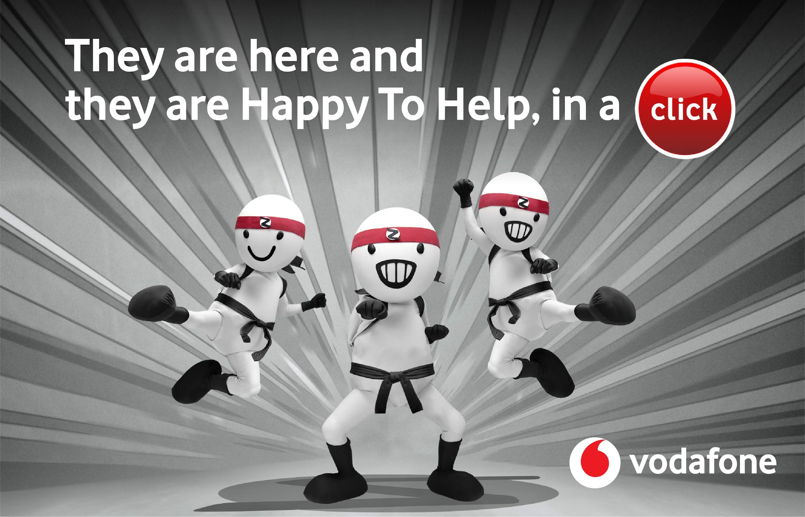
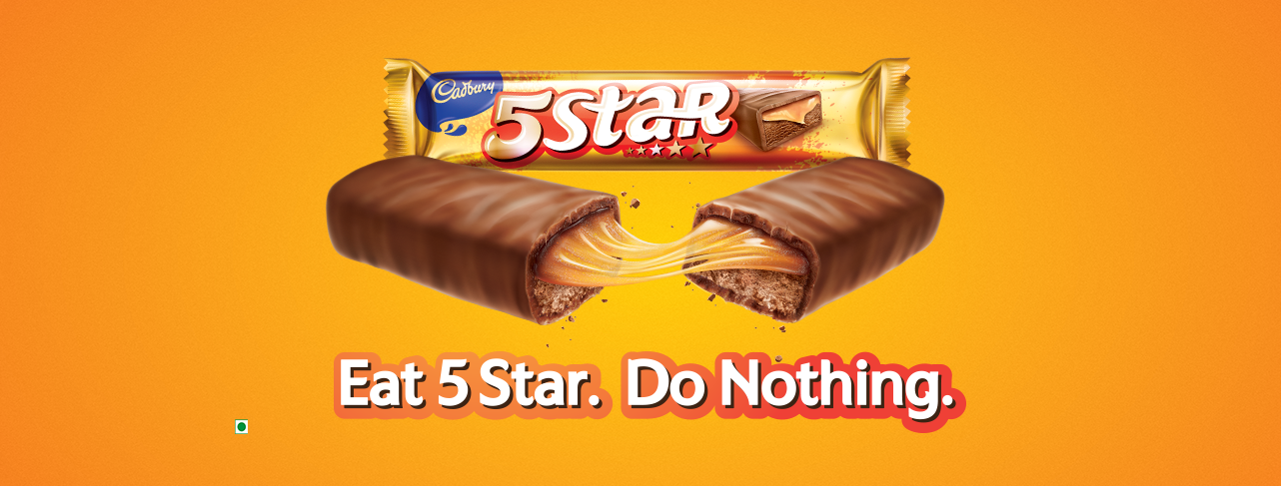
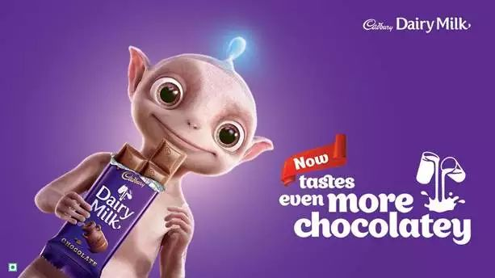
Vodafone
5 star
Amul

Slide 3
Storytelling….
1. Captivates
2. Connects
3. Inspires

Slide 4
Why Storytelling Matters?
Connect with your audience on an emotional level.
Make your brand memorable.
Drive engagement

Slide 5
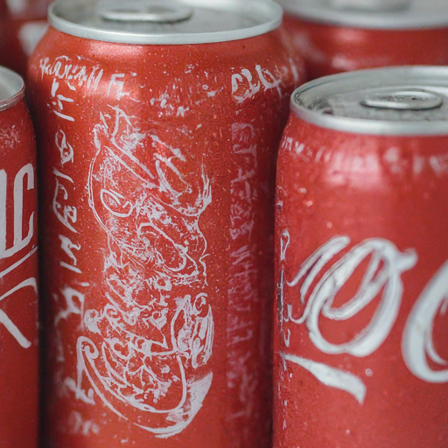
The "Share a Coke" Campaign: A Storytelling Masterclass
Launched in 2011, the "Share a Coke" campaign was a global phenomenon that replaced the Coca-Cola logo with popular names on cans and bottles.

Slide 6
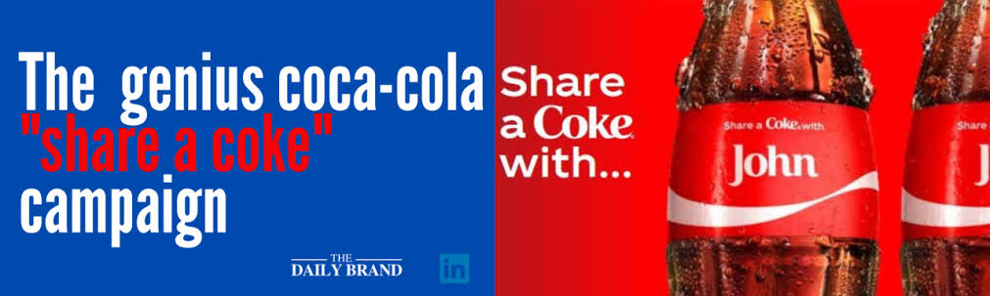
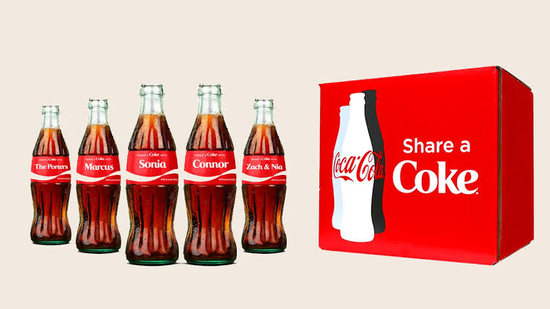
Personalized coke by replacing their logo with their loved ones name

Slide 7

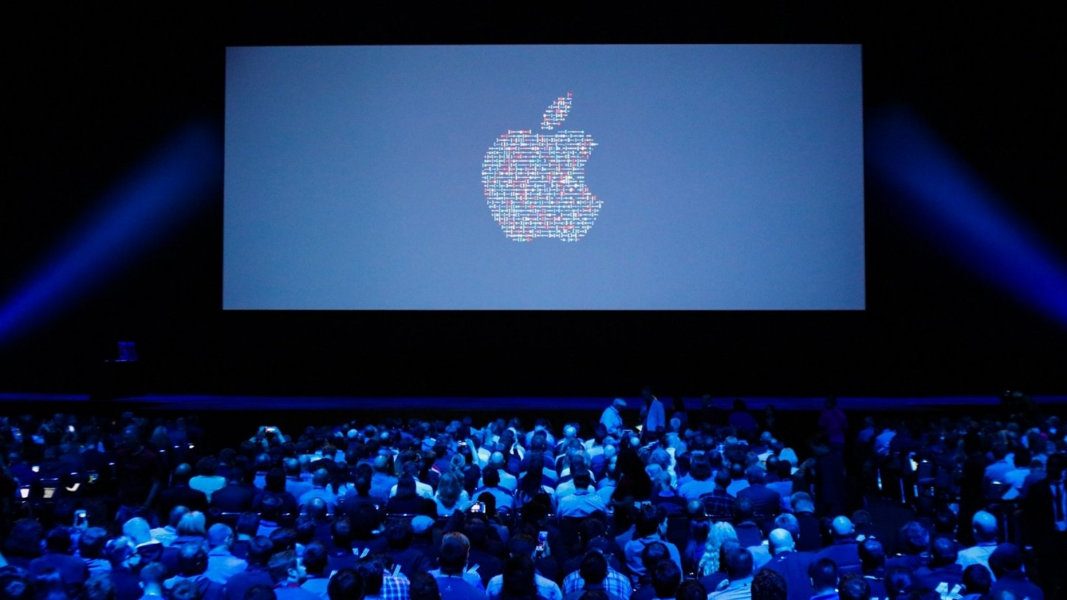
Nike's Just Do It Campaign
Apple’s Product Launch Events

Slide 8

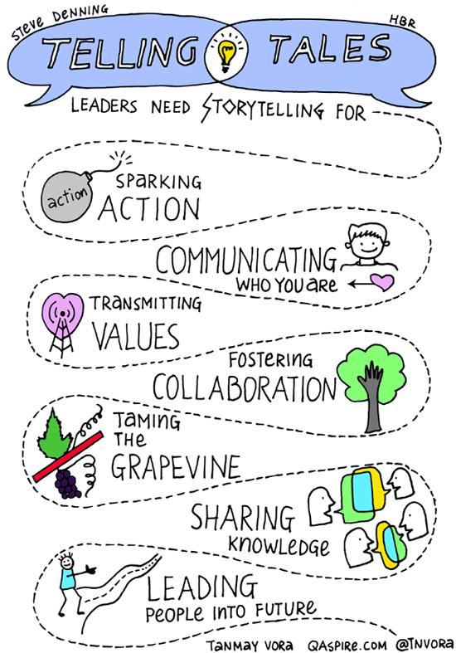
Not just in marketing……..

Slide 9
Storytelling
1. Evoke emotions
2. Convey messages
3. Foster Communication
This makes it an essential component in human communation and expression

Slide 10
"The most powerful person in the world is the storyteller. The storyteller sets the vision, values, and agenda of an entire generation that is to come."
- Steve Jobs

